Slide 1
Greedy Method
Dr. Md. Ali Hossain
Assistant Professor
Department of CSE
Email. Ali.Hossain@ruet.ac.bd

Slide 2
Greedy Method
It is a design technique applied to those problems having n inputs and requires us to obtain a subset that satisfies some constraints.
Any subset that satisfies these constraints is called a feasible solution.
Ultimate goal is to find a feasible solution that minimizes or maximizes an objective function; this solution is known as optimal solution.
3 -<number>

Slide 3
Greedy Algorithm
// a[1:n] contains the n inputs
#Algorithm Greedy ( a, n )
{
solution = Ø; // Initialize the solution
for i = 1 to n do
{
x = Select ( a );
if Feasible ( solution, x ) ) then
solution = Union( solution, x)
}
return ( solution );
}
3 -<number>

Slide 4
Knapsack
A 1998 study of the Stony Brook University Algorithm Repository showed that, out of 75 algorithmic problems, the knapsack problem was the 18th most popular and the 4th most needed after kd-trees, suffix trees, and the bin packing problem
3 -<number>

Slide 5
Knapsack problem
Given a set of items, each with a mass and a value, determine the number of each item to include in a collection so that the total weight is less than or equal to a given limit and the total value is as large as possible
It derives its name from the problem faced by someone who is constrained by a fixed-size knapsack and must fill it with the most valuable items
3 -<number>

Slide 6
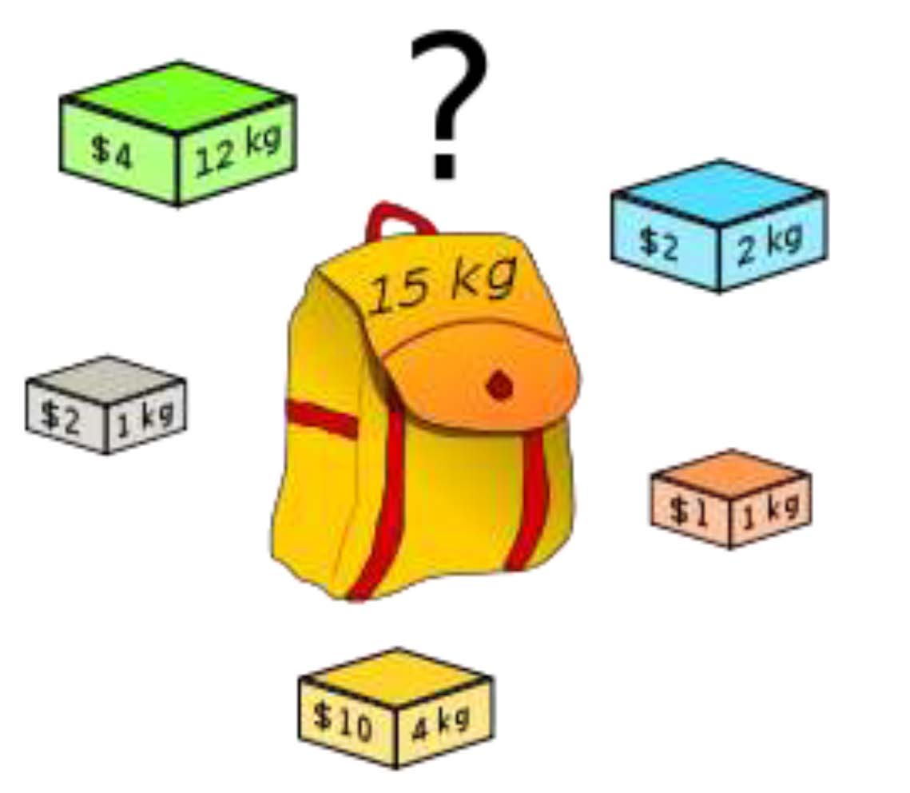
Fill Your Shopping Bag: Save Money!!!
which boxes should be chosen to maximize the amount of money while still keeping the overall weight under or equal to 15 kg?
Answer: 3 yellow boxes and 3 grey boxes .
3 -<number>

Slide 7
Knapsack Problem
To get maximum profit, such that weight in the knapsack do not exceed its capacity.
Given ‘n’ objects and a knapsack(bag).
Object i have a weight W_{i}, and the knapsack has a capacity m.
if object i is placed into knapsack then a profit of P_{i} is earned.
Since the knapsack capacity is m, we require the total weight of all chosen objects to be at most m.
3 -<number>

Slide 8
Knapsack Problem Contd..
W_{i} x_{i} > m (problem!!!. Bag is full already)
W_{i} x_{i} ≤ m (item placed such that not to exceed the weight of bag)
3 -<number>

Slide 9
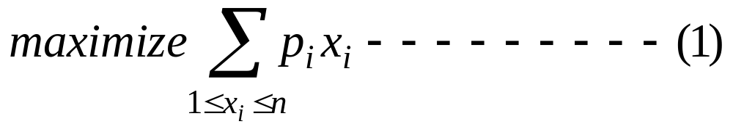
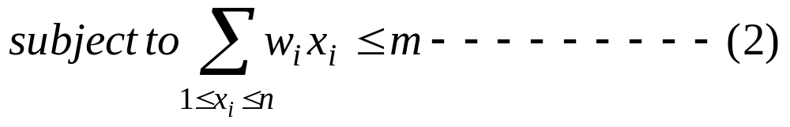
Knapsack Problem Contd..
Knapsack problem can be summarize as follows:
3 -<number>

Slide 10
Types of Knapsack Problem
There are two versions of the problem:
“0-1 knapsack problem”
    Items are indivisible; you either take an item or not. Some special instances can be solved with dynamic programming
“Fractional knapsack problem”
    Items are divisible: you can take any fraction of an item
3 -<number>

Slide 11
Example #1
Weight
Benefit
Item
#
w_{i}
b_{i}
1
2
3
w₁ =2
b₁ =3
w₂ =4
b₂ =5
w₃ =5
b₃ =8
w₅ =9
b₅ =10
2
4
5
S
3
5
8
4
3
4
For S:
Total weight: 20
Maximum benefit: 26
5
9
10
3 -<number>

Slide 12
Example #2
w₁ =2
b₁ =3
w₂ =4
b₂ =5
w₃ =5
b₃ =8
w₄ =3
b₄ =4
Weight
Benefit
Item
#
w_{i}
b_{i}
?
1
2
3
Max weight: W = 20
For S₄:
Total weight: 14
Maximum benefit: 20
S₄
2
4
5
S₅
3
5
8
4
3
4
5
9
10
w₁ =2
b₁ =3
w₂ =4
b₂ =5
w₃ =5
b₃ =8
w₅ =9
b₅ =10
Solution for S₄ is not part of the solution for S₅!!!
For S₅:
Total weight: 20
Maximum benefit: 26
3 -<number>

Slide 13
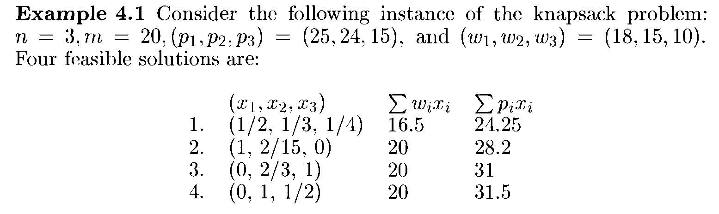
Analyze the Algorithm in Depth
Solution 1
Solution 2
Solution 3
Solution 4
Q. Find out the optimal solution (i.e., maximize profit in capacity of 20)
3 -<number>

Slide 14
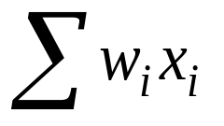
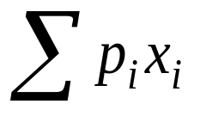
Solution 1
Objective: Maximize the total profit
Strategy 1: Take the objects with maximum profit.
Solution :
Solution vector:
X=[1, 2/15, 0] | 20 | 28.2
3 -<number>

Slide 15
Solution 2
Analytical result: Considering objects in decreasing of profit will not yield the optimal solution
Strategy 2: Take the objects with minimum weight.
Solution :
Solution vector:
X=[0, 2/3, 1] | 20 | 31
3 -<number>

Slide 16
Solution 3
Analytical result: Considering objects in decreasing of weight will also yield the suboptimal solution
Strategy 3: Take the objects with maximum profit per unit of capacity used.
Order the weights and profit according to the ratio of p_{i}/w_{i}
Solution :
Solution vector:
X=[0, 1, 1/2] | 20 | 31.5
Bravo: Optimal solution
reached.
3 -<number>

Slide 17
Greedy Knapsack algorithm
#Algorithm GreedyKnapsack( m, n )
//P[1:n] and w[1:n] contains the profit and weight respectively in decreasing order // of p_{i}/w_{i.} m=knapsack size.
{
for i = 1 to n do x[i]=0.0 //initialize the solution vector
U= m;
for i = 1 to n do
{
if (x[i]>U) Then break;
x[i] = 1.0; U=U-w[i];
}
if(i<=n) then x[i]=U/w[i];
}
3 -<number>

Slide 18
Job Sequencing with Deadlines
Dr. Md. Ali Hossain
Assistant Professor
Department of CSE
Email. Ali.Hossain@ruet.ac.bd
3 -<number>

Slide 19
Job Sequencing with Deadlines
Example: n=4, (p₁,p₂,p₃,p₄)=(100,10,15,27), (d₁,d₂,d₃,d₄)=(2,1,2,1)
      Feasible Processing
      Solution sequence Value
    1. (1, 2) 2, 1 110
    2. (1, 3) 1, 3 or 3, 1 115
    3. (1, 4) 4, 1 127
    4. (2, 3) 2, 3 25
    5. (3, 4) 4, 3 42
    6. (1) 1 100
    7. (2) 2 10
    8. (3) 3 15
    9. (4) 4 27
3 -<number>

Slide 20



Job Sequencing with Deadlines Contd..
Greedy strategy using total profit as optimization function
  Applying to previous example
    Begin with J=φ
    Job 1 considered, and added to J → J={1}
    Job 4 considered, and added to J → J={1,4}
    Job 3 considered, but discarded because not feasible → J={1,4}
    Job 2 considered, but discarded because not feasible → J={1,4}
    Final solution is J={1,4} with total profit 127
  It is optimal
How to determine the feasibility of J ?
  Trying out all the permutations
    Computational explosion since there are n! permutations
  Possible by checking only one permutation
    By Theorem 4.3
Theorem 4.3 Let J be a set of k jobs and a permutation of jobs in J such that Then J is a feasible solution iff the jobs in J can be processed in the order without violating any deadline.
3 -<number>

Slide 21
Job Sequencing with Deadlines Contd..
The greedy method described above always obtains an optimal solution to the job sequencing problem.
High level description of job sequencing algorithm
  Assuming the jobs are ordered such that p[1]≥p[2]≥…≥p[n]
GreedyJob(int a[], set J, int n)
// J is a set of jobs that can be
// completed by their deadlines.
{
J = {1};
for (int i=2; i<=n; i++) {
if (all jobs in J ∪{i} can be completed
by their deadlines) J = J ∪{i};
}
}
3 -<number>

Slide 22

Spanning Trees
3 -<number>

Slide 23
Minimum Spanning Trees
Let G = (V, E) be an undirected connected graph.
A subgraph t = (V, E’) of G is a spanning tree of G iff t is a tree.
Spanning tree is a minimal subgraph G’ of a graph G such that V (G’) = V (G) and G’ is connected
A connected graph with n vertices and n-1 edges is a trees
Minimum spanning tree(MST) : a spanning tree with the smallest total weight/cost.
3 -<number>

Slide 24
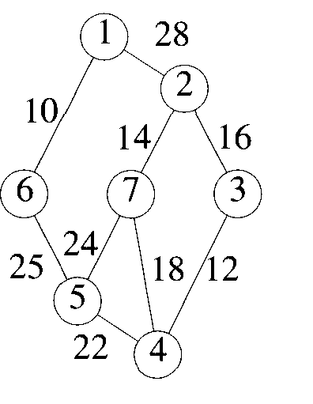
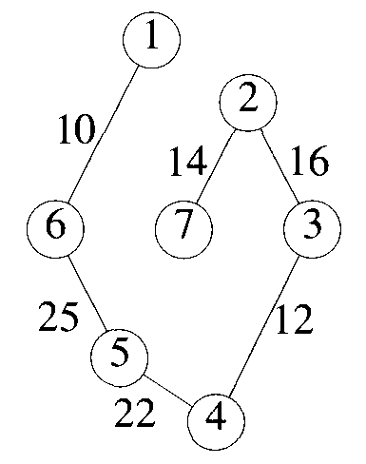
An Example of MST
A graph and one of its minimum costs spanning tree
3 -<number>

Slide 25
Prim’s Algorithm
In Prim’s algorithm, grow the tree one edge at a time
The edge is chosen based on some optimization criterion
Select an edge that increases the overall weight of the tree by a minimum amount
Set of edges A selected thus far forms a tree
The next edge (u, v) to be included in A is a minimum cost edge not in A with the property that
AU(u, v) is also a tree
3 -<number>

Slide 26
Growing MST
Manage a set A that is always a subset of some minimum spanning tree
At each step, an edge (u, v) is determined such that AU (u, v) is also a subset of a minimum spanning tree
(u, v) is called a safe edge
Two popular algorithms used to implement minimum spanning tree
Prims algorithm
Kruskal’s algorithm
3 -<number>

Slide 27
Prim’s Algorithm
Start with any arbitrarily selected vertex
A way to select the starting point is to start with the two vertices of the minimum cost edge
The set A of edges so far selected form a tree
The next edge (u, v) to be included in A is a minimum cost edge not in A such that A U (u, v) is also a tree
With each vertex, associate a value called near[j] with each vertex j that is not yet included in the tree
near[j] refers to the vertex in the tree such that
cost(j, near[j]) is minimum for all choices for near[j]
3 -<number>

Slide 28
Prim’s Algorithm Contd..
Change near[j] to α for all vertices j that are already in the tree
Add a vertex to the set by looking for the closest vertex to the current tree
The time complexity of Prims algorithm is
O(n²) where n is the number of vertices.
3 -<number>

Slide 29
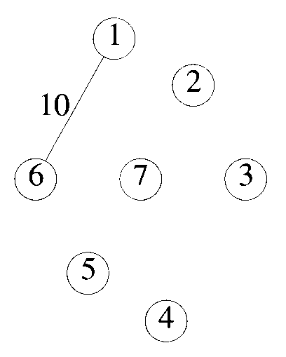
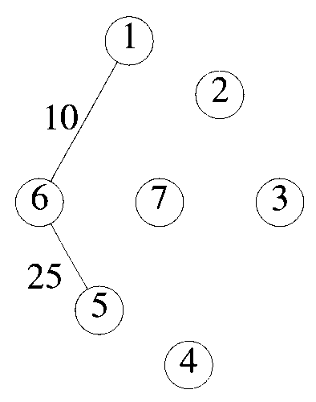
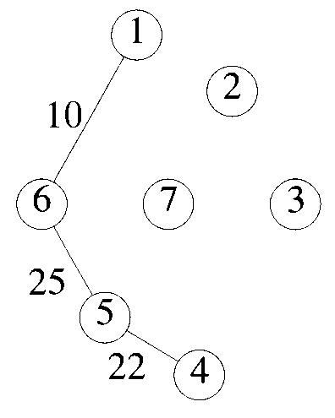
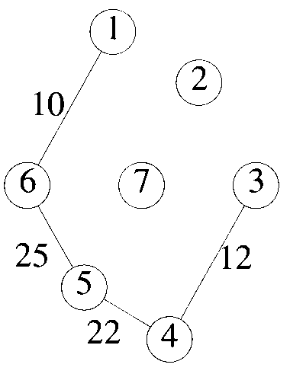
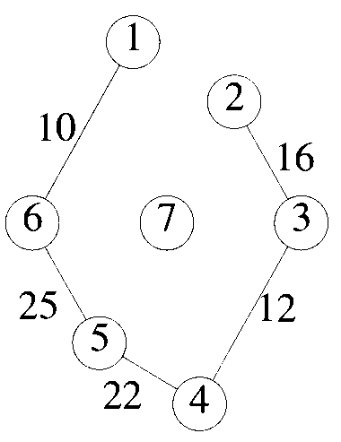
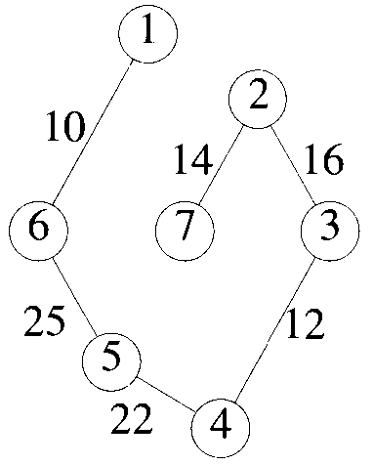
Example # for Prim’s Algorithm
3 -<number>

Slide 30
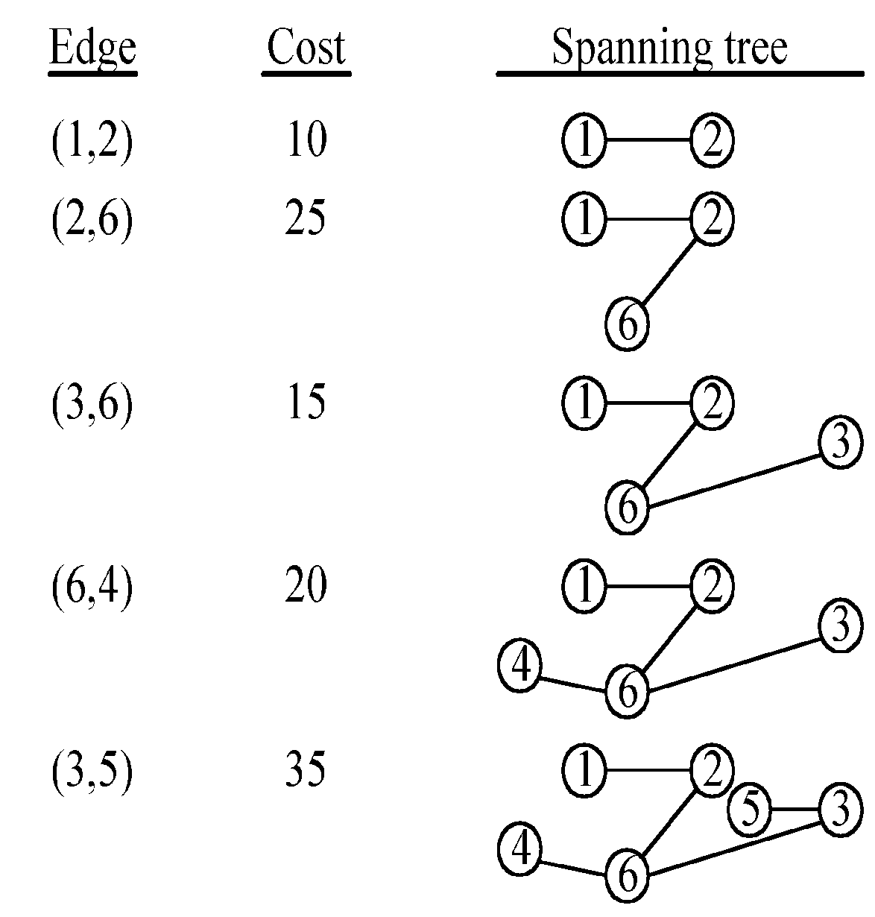
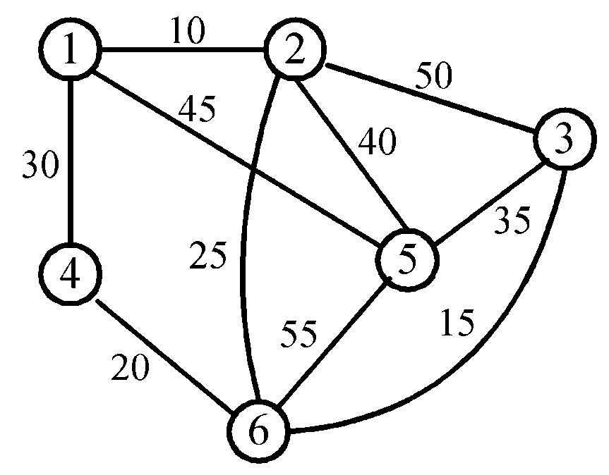
Example #2 for Prim’s Algorithm
3 -<number>

Slide 31
Kruskal’s Algorithm (MST)
Step 1: Sort all edges into nondecreasing order of cost.
Step 2: Add the next smallest weight edge to the forest if it will not create a cycle.
Step 3: Stop if n-1 edges. Otherwise, go to Step2.
3 -<number>

Slide 32
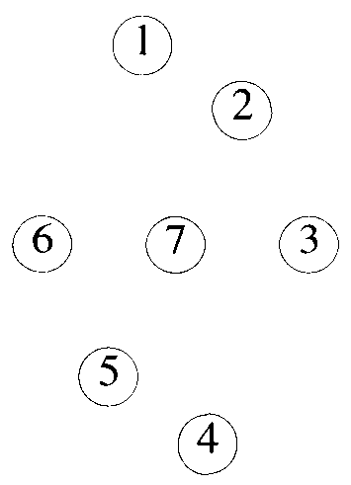
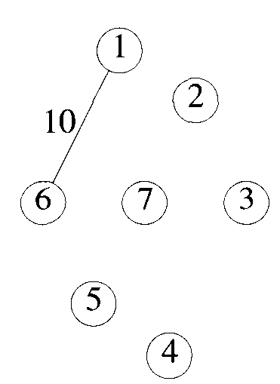
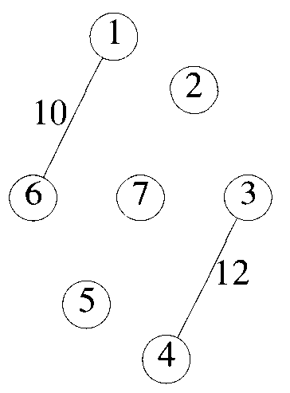
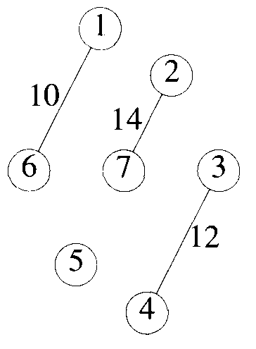
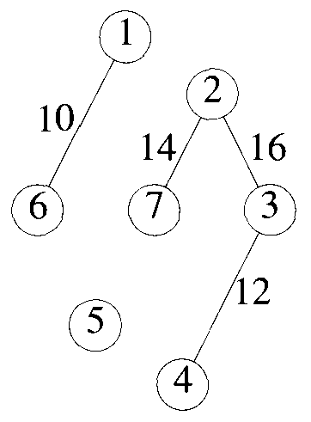
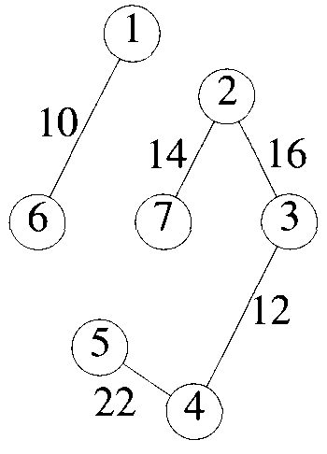
Example#1 of Kruskal’s Algorithm
Edge | Cost
(1,2) | 10
(3,4) | 12
(2,7) | 14
(2, 3) | 16
(4, 7) | 18
(4, 5) | 22
(5, 7) | 24
(5, 6) | 25
(1, 2) | 28
Total cost: 99
3 -<number>

Slide 33
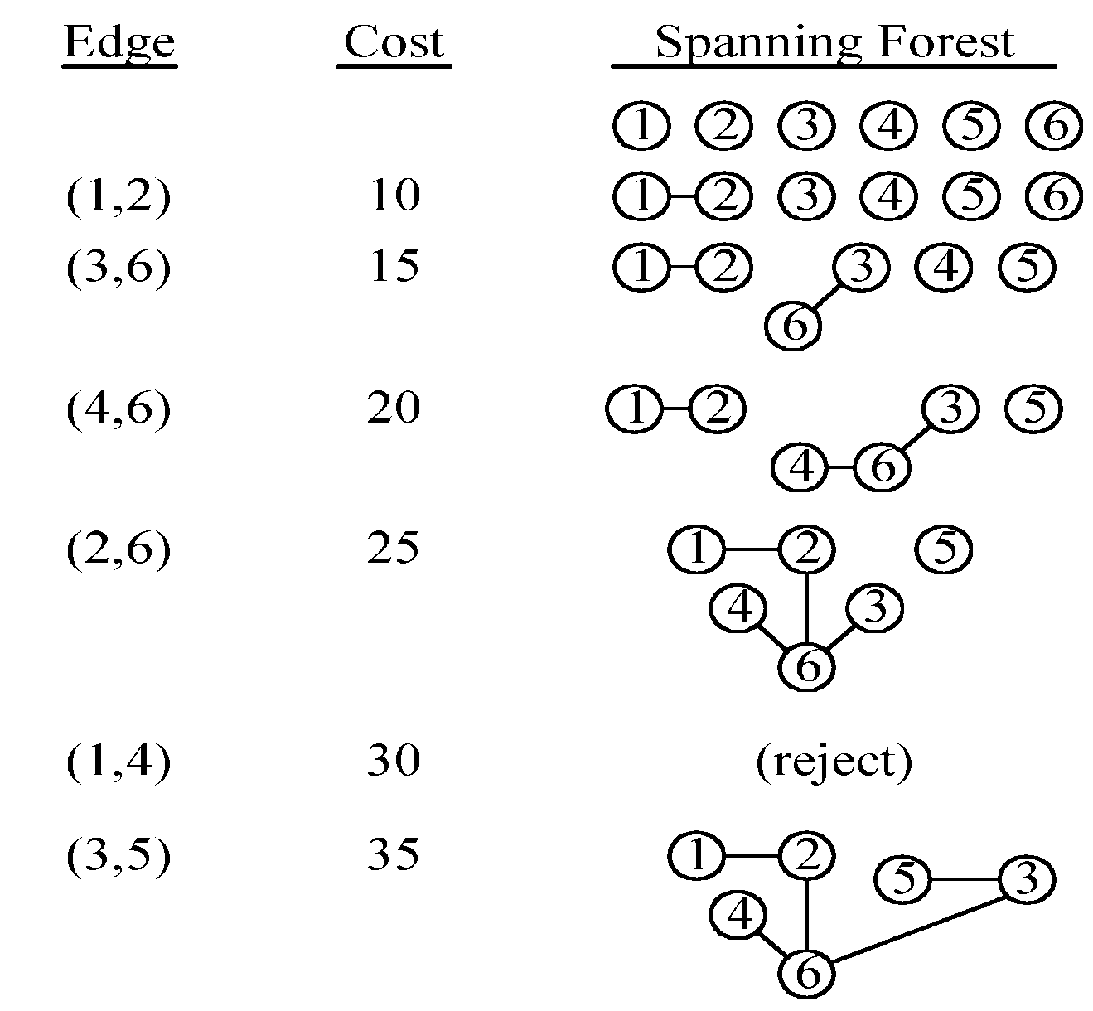
Example#2 for Kruskal’s Algorithm
3 -<number>

Slide 34
Time Complexity
Time complexity: O(|E| log|E|)
  |E| is the number of edges
3 -<number>

Slide 35
Thanks for the attention
3 -<number>

Slide 36
The details for constructing MST
How do we check if a cycle is formed when a new edge is added?
  By the SET and UNION method.
Each tree in the spanning forest is represented by a SET.
  If (u, v) ∈ E and u, v are in the same set, then the addition of (u, v) will form a cycle.
  If (u, v) ∈ E and u∈S₁ , v∈S₂ , then perform UNION of S₁ and S₂ .
3 -<number>

Slide 37
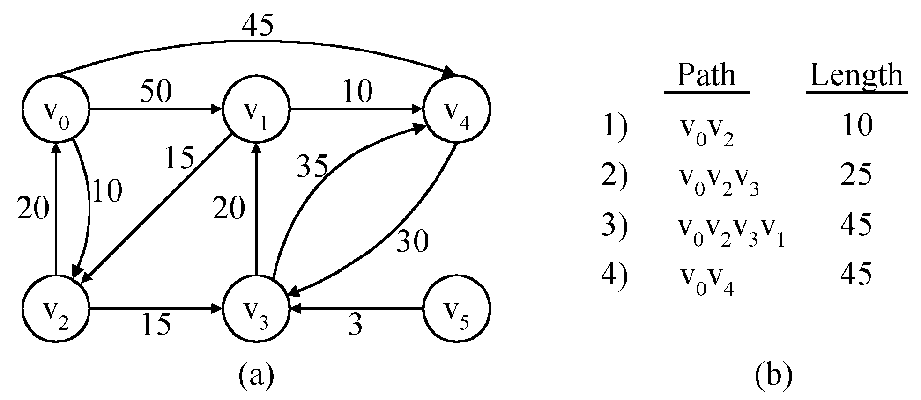
The single-source shortest path problem
shortest paths from v₀ to all destinations
3 -<number>

Slide 38
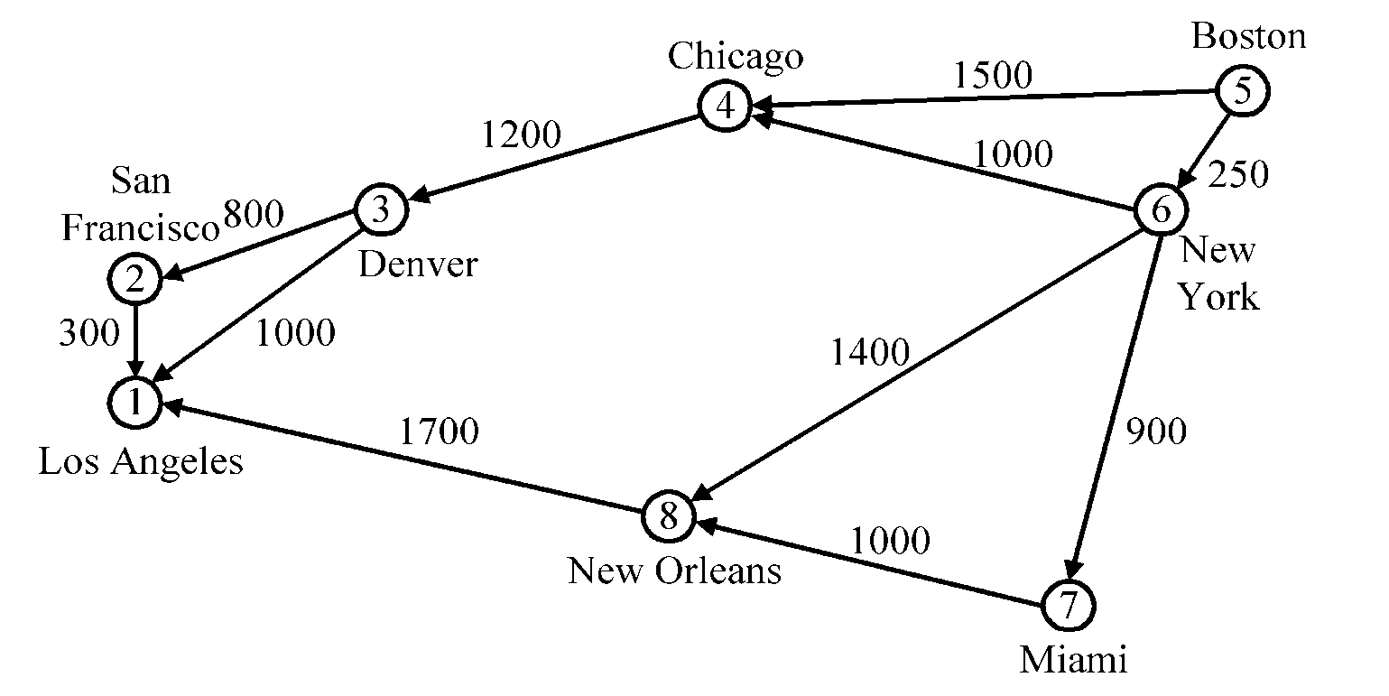
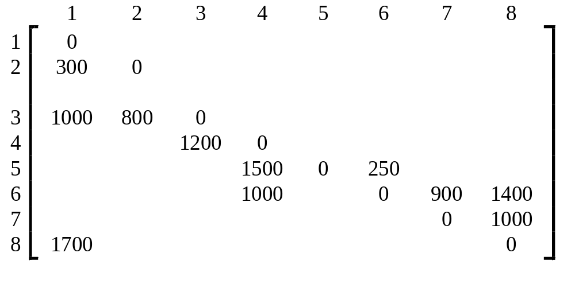
Dijkstra’s algorithm
In the cost adjacency matrix, all entries not shown are +∞.
3 -<number>

Slide 39
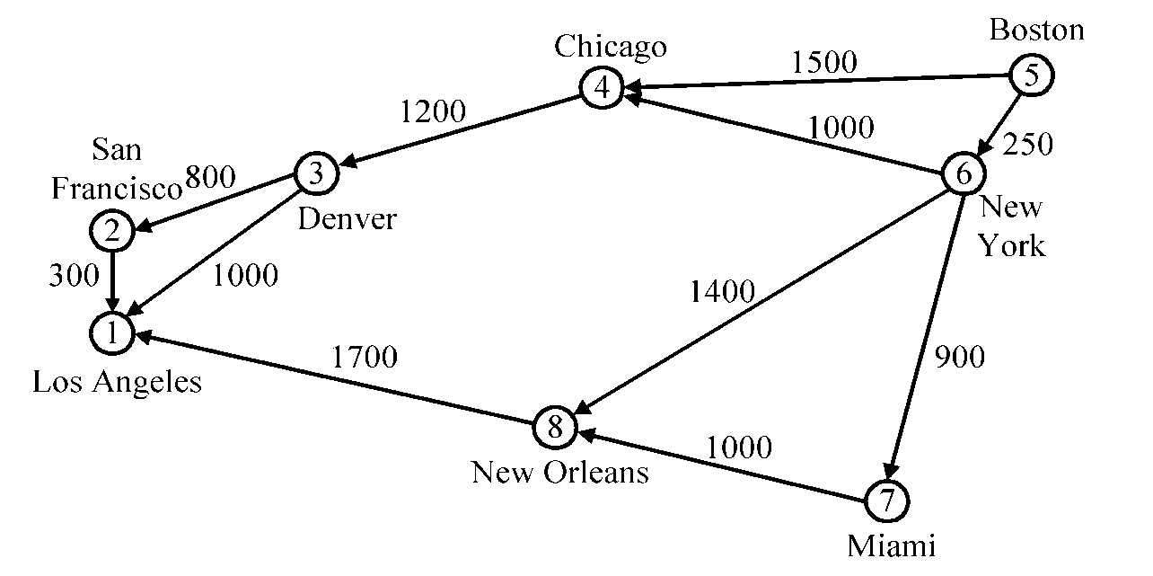
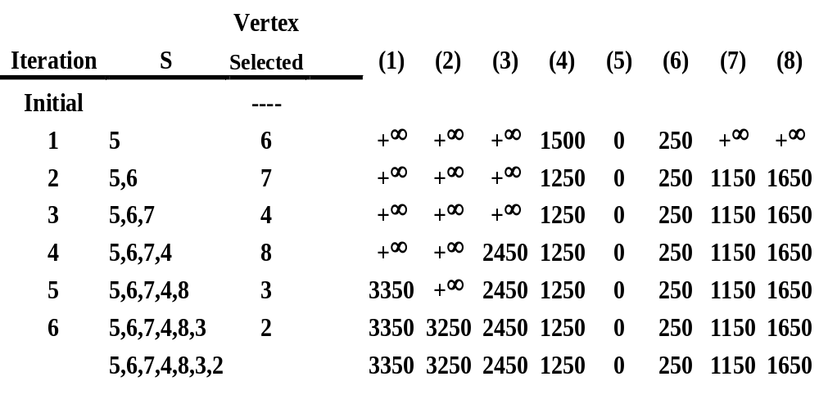
Time complexity : O(n²), n = |V|.
3 -<number>

Slide 40
The longest path problem
Can we use Dijkstra’s algorithm to find the longest path from a starting vertex to an ending vertex in an acyclic directed graph?
There are 3 possible ways to apply Dijkstra’s algorithm:
  Directly use “max” operations instead of “min” operations.
  Convert all positive weights to be negative. Then find the shortest path.
  Give a very large positive number M. If the weight of an edge is w, now M-w is used to replace w. Then find the shortest path.
All these 3 possible ways would not work!
3 -<number>

Slide 41
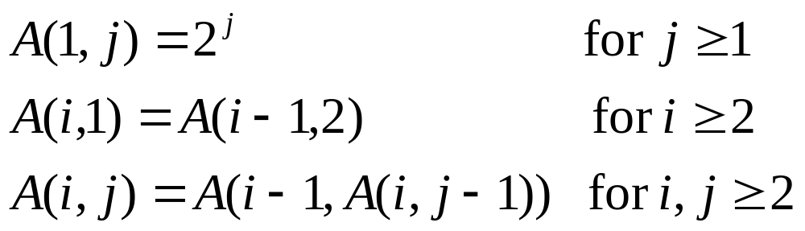
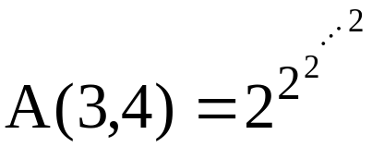

Ackermann’s function
⇒ A(p, q+1) > A(p, q), A(p+1, q) > A(p, q)
65536 two’s
3 -<number>

Slide 42
Inverse of Ackermann’s function
α(m, n) = min{i≥1|A(i, ⎣m/n⎦) > log₂n}
Practically, A(3,4) > log₂n
⇒α(m, n) ≤ 3
⇒α(m, n) is almost a constant.
3 -<number>

Slide 43
CPM for the longest path problem
The longest path(critical path) problem can be solved by the critical path method(CPM) :
Step 1:Find a topological ordering.
Step 2: Find the critical path.
(see [Horiwitz 1995].)
  [[Horowitz 1995] E. Howowitz, S. Sahni and D. Metha, Fundamentals of Data Structures in C++, Computer Science Press, New York, 1995
3 -<number>

Slide 44
The 2-way merging problem
# of comparisons required for the linear 2-way merge algorithm is m₁+ m₂ -1 where m₁ and m₂ are the lengths of the two sorted lists respectively.
  2-way merging example
2 3 5 6
1 4 7 8
The problem: There are n sorted lists, each of length m_{i}. What is the optimal sequence of merging process to merge these n lists into one sorted list ?
3 -<number>

Slide 45
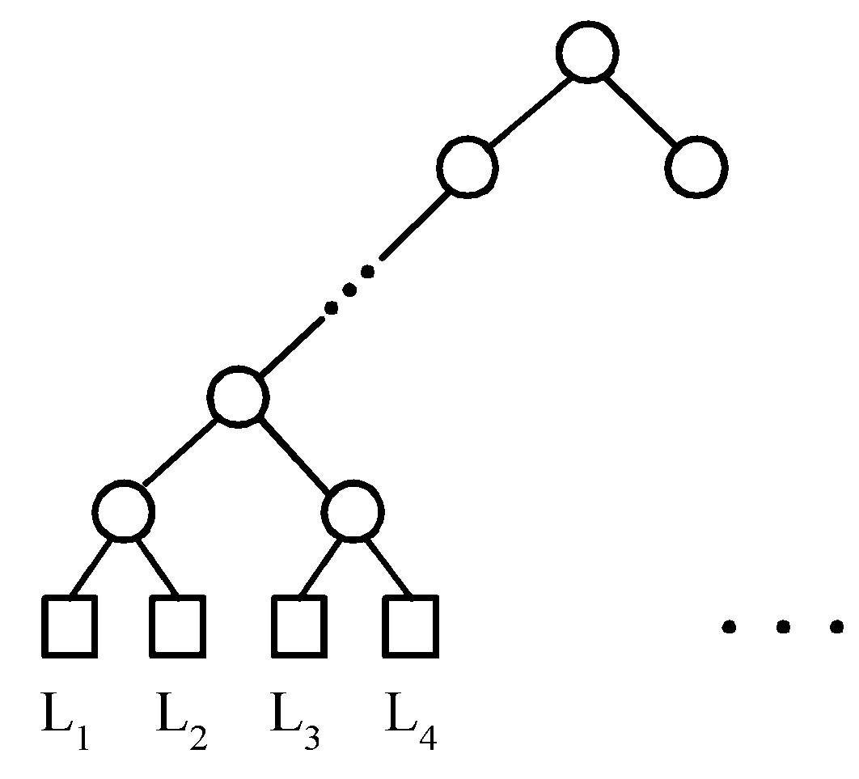
Extended binary trees
An extended binary tree representing a 2-way merge
3 -<number>

Slide 46
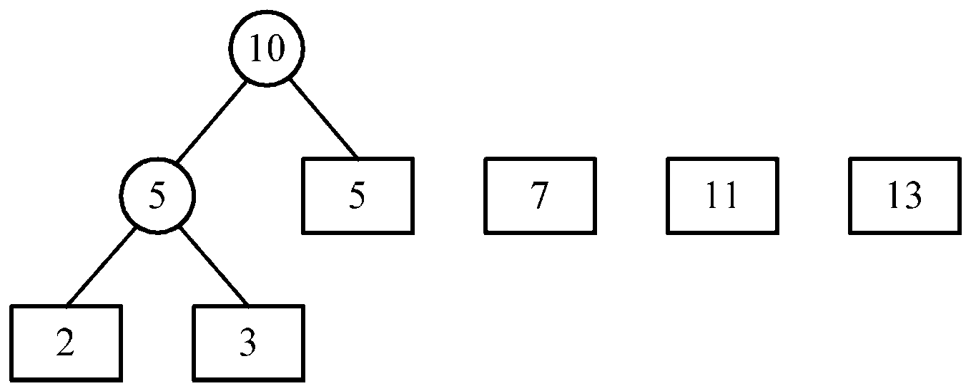
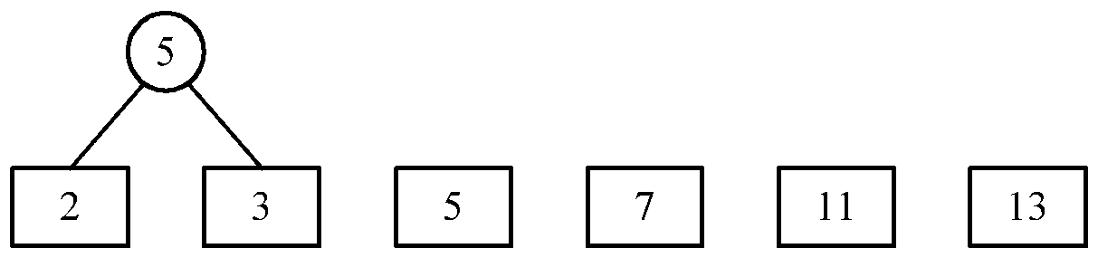
An example of 2-way merging
Example: 6 sorted lists with lengths 2, 3, 5, 7, 11 and 13.
3 -<number>

Slide 47
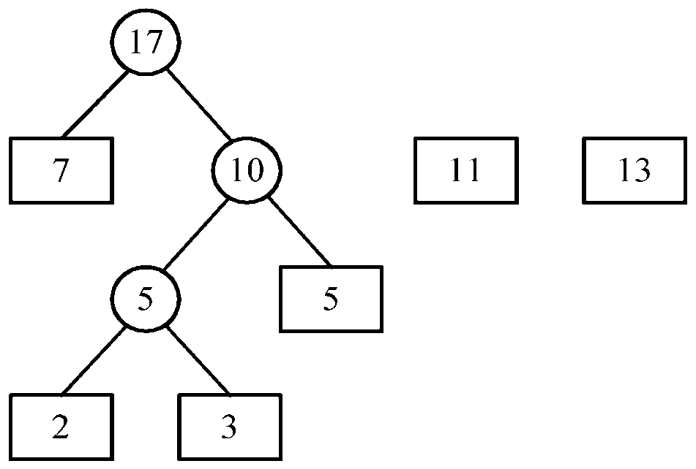
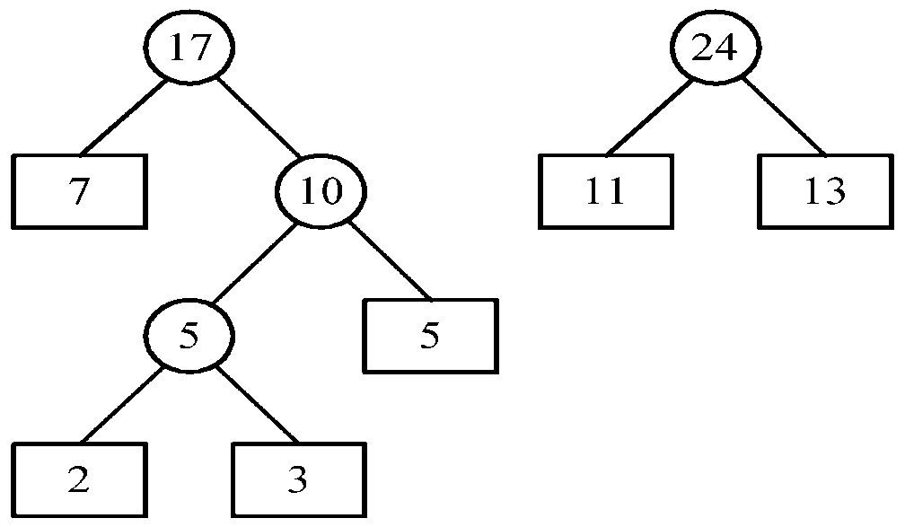
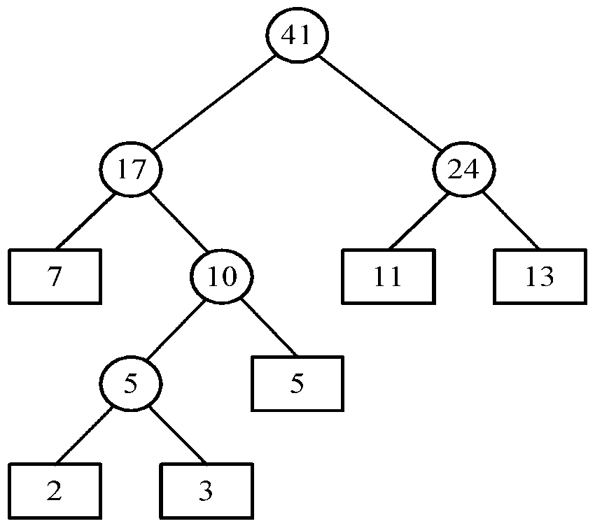
Time complexity for generating an optimal extended binary tree:O(n log n)
3 -<number>

Slide 48
Huffman codes
In telecommunication, how do we represent a set of messages, each with an access frequency, by a sequence of 0’s and 1’s?
To minimize the transmission and decoding costs, we may use short strings to represent more frequently used messages.
This problem can by solved by using an extended binary tree which is used in the 2-way merging problem.
3 -<number>

Slide 49
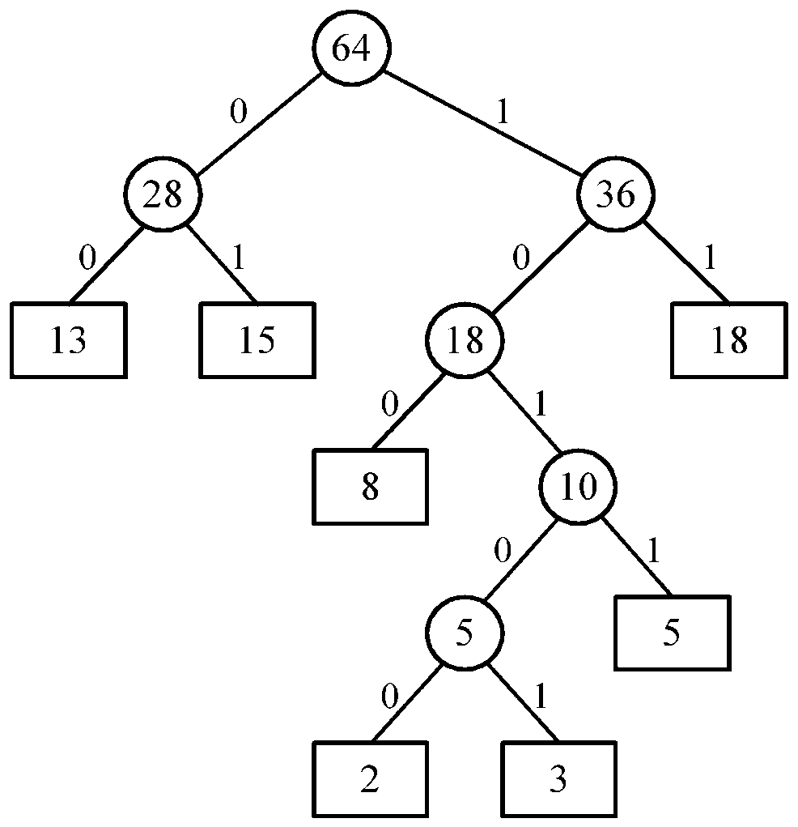
An example of Huffman algorithm
Symbols: A, B, C, D, E, F, G
freq. : 2, 3, 5, 8, 13, 15, 18
Huffman codes:
A: 10100 B: 10101 C: 1011
D: 100 E: 00 F: 01
G: 11
A Huffman code Tree
3 -<number>

Slide 50
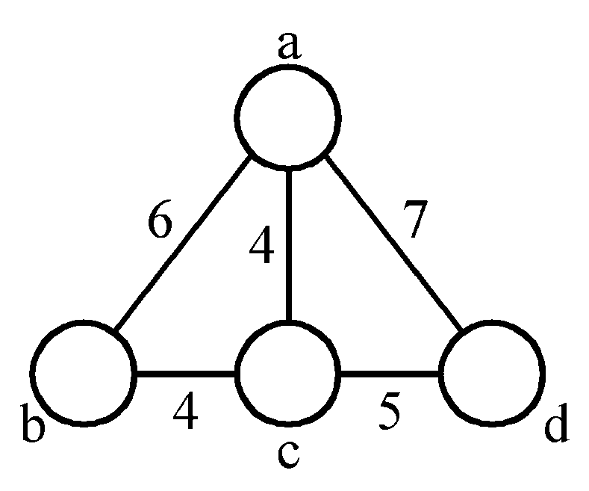
The minimal cycle basis problem
3 cycles:
A₁ = {ab, bc, ca}
A₂ = {ac, cd, da}
A₃ = {ab, bc, cd, da}
where A₃ = A₁ ⊕ A₂
(A ⊕ B = (A∪B)-(A∩B))
A₂ = A₁ ⊕ A₃
A₁ = A₂ ⊕ A₃
Cycle basis : {A₁, A₂} or {A₁, A₃} or {A₂, A₃}
3 -<number>

Slide 51
Def : A cycle basis of a graph is a set of cycles such that every cycle in the graph can be generated by applying ⊕ on some cycles of this basis.
Minimal cycle basis : smallest total weight of all edges in this cycle.
e.g. {A₁, A₂}
3 -<number>

Slide 52
Algorithm for finding a minimal cycle basis:
  Step 1: Determine the size of the minimal cycle basis, demoted as k.
  Step 2: Find all of the cycles. Sort all cycles( by weight).
  Step 3: Add cycles to the cycle basis one by one. Check if the added cycle is a linear combination of some cycles already existing in the basis. If it is, delete this cycle.
  Step 4: Stop if the cycle basis has k cycles.
3 -<number>

Slide 53
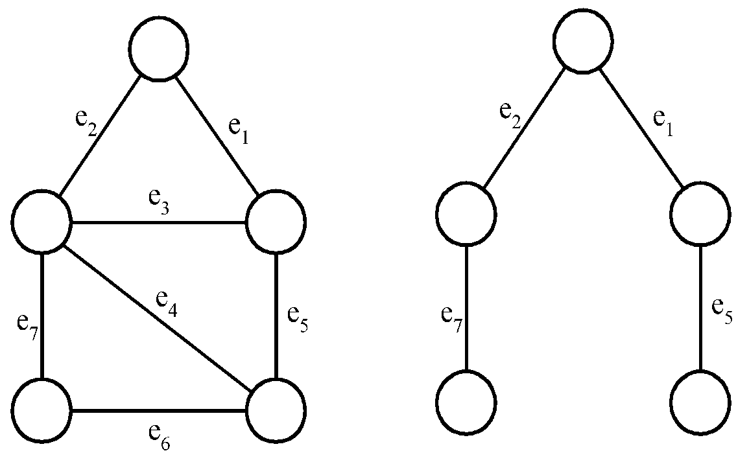
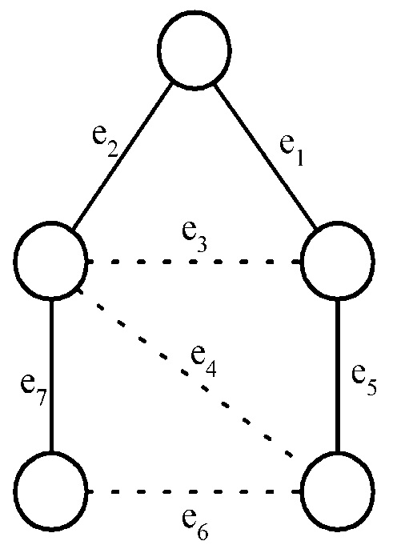
Detailed steps for the minimal cycle basis problem
Step 1 :
A cycle basis corresponds to the fundamental set of cycles with respect to a spanning tree.
a graph
a spanning tree
a fundamental set of cycles
# of cycles in a cycle basis :
= k
= |E| - (|V|- 1)
= |E| - |V| + 1
3 -<number>

Slide 54
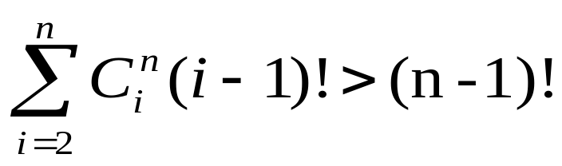
Step 2:
How to find all cycles in a graph?
[Reingold, Nievergelt and Deo 1977]
How many cycles in a graph in the worst case?
In a complete digraph of n vertices and n(n-1) edges:
Step 3:
  How to check if a cycle is a linear combination of some cycles?
  Using Gaussian elimination.
3 -<number>

Slide 55
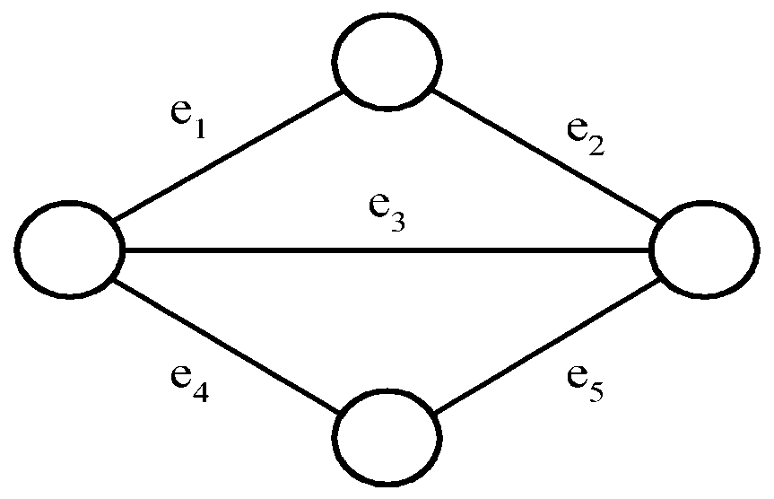
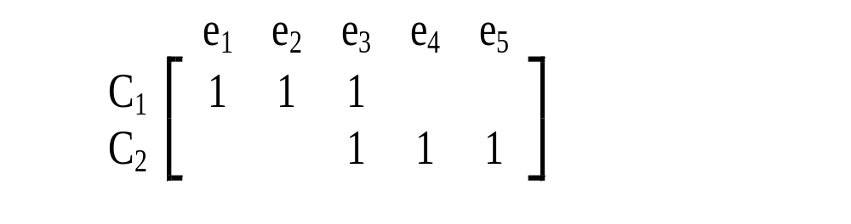
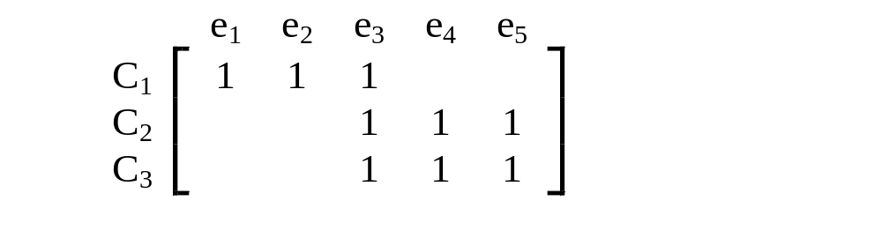
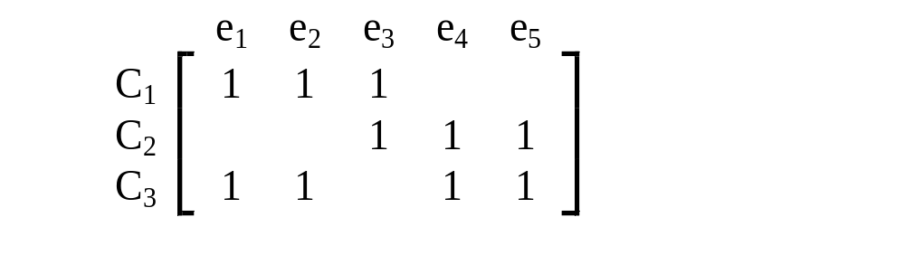
Gaussian elimination
2 cycles C₁ and C₂ are represented by a 0/1 matrix
E.g.
⊕ on rows 1 and 3
Add C₃
on rows 2 and 3 : empty
∵C₃ = C₁ ⊕ C₂
3 -<number>

Slide 56
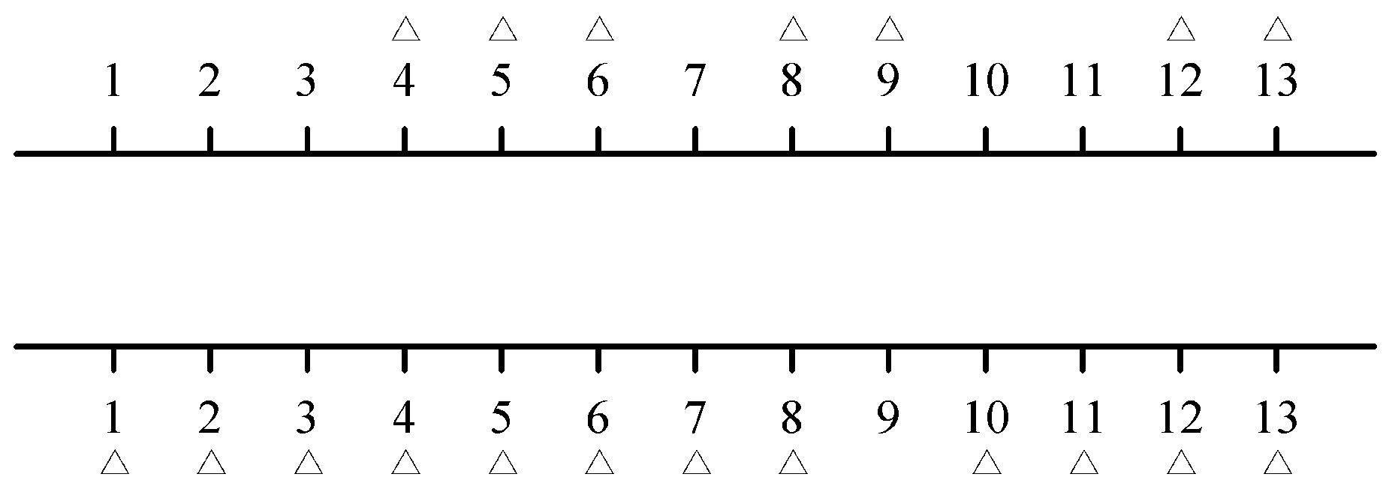
The 2-terminal one to any special channel routing problem
Def: Given two sets of terminals on the upper and lower rows, respectively, we have to connect each upper terminal to the lower row in a one to one fashion. This connection requires that # of tracks used is minimized.
3 -<number>

Slide 57

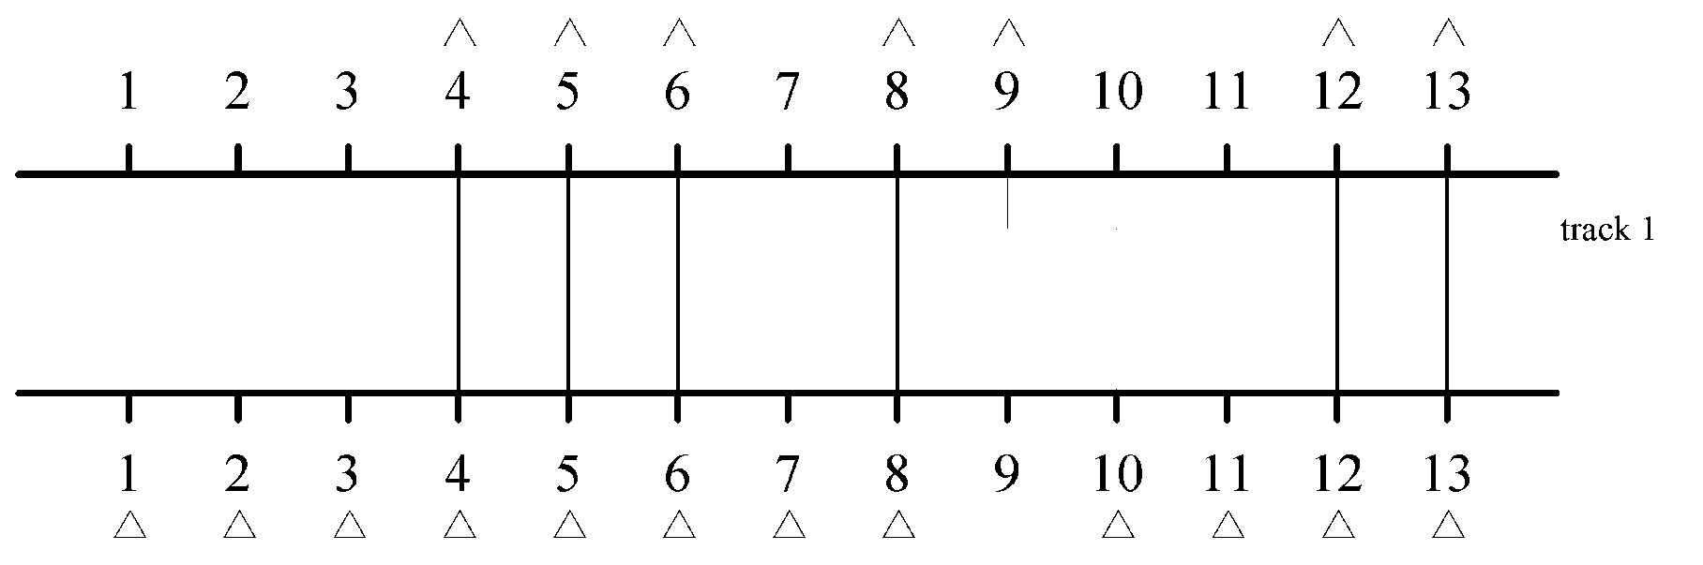
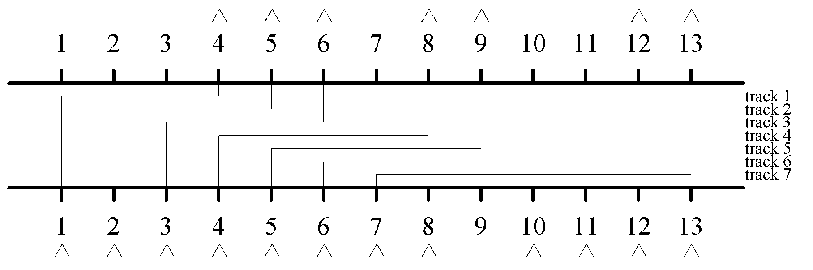
2 feasible solutions
3 -<number>

Slide 58
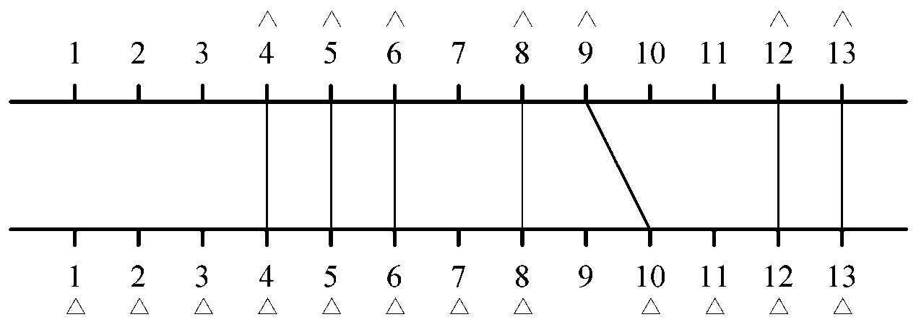
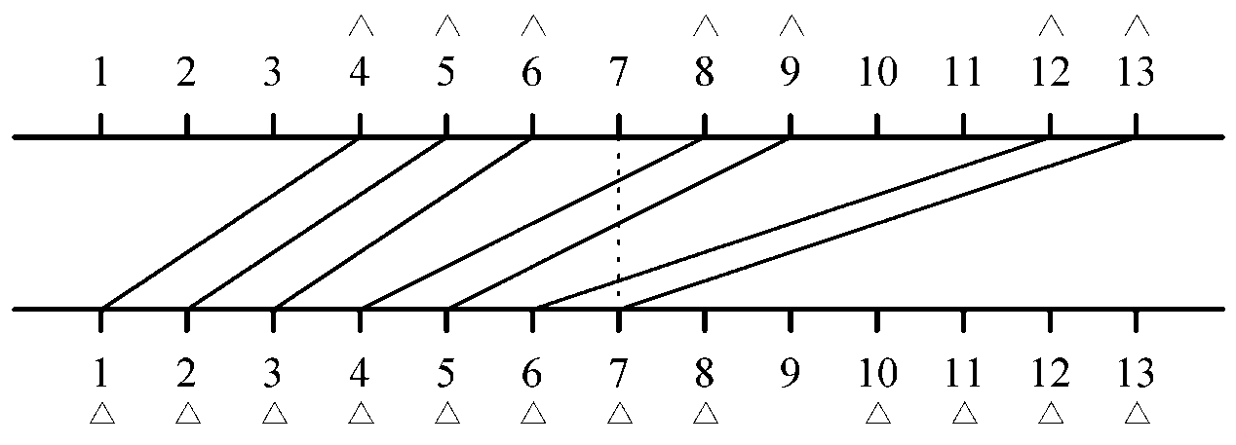
Redrawing solutions
(a) Optimal solution
(b) Another solution
3 -<number>

Slide 59

At each point, the local density of the solution is # of lines the vertical line intersects.
The problem: to minimize the density. The density is a lower bound of # of tracks.
Upper row terminals: P₁ ,P₂ ,…, P_{n} from left to right
Lower row terminals: Q₁ ,Q₂ ,…, Q_{m} from left to right m > n.
It would never have a crossing connection:
3 -<number>

Slide 60
Suppose that we have a method to determine the minimum density, d, of a problem instance.
The greedy algorithm:
Step 1 : P₁ is connected Q₁.
Step 2 : After P_{i} is connected to Q_{j}, we check whether P_{i+1} can be connected to Q_{j+1}. If the density is increased to d+1, try to connect P_{i+1} to Q_{j+2}.
Step 3 : Repeat Step2 until all P_{i}’s are connected.
3 -<number>

Slide 61


The knapsack problem
n objects, each with a weight w_{i} > 0
a profit p_{i} > 0
capacity of knapsack: M
Maximize
Subject to
0 ≤ x_{i} ≤ 1, 1 ≤ i ≤ n
3 -<number>

Slide 62
The knapsack algorithm
The greedy algorithm:
Step 1: Sort p_{i}/w_{i} into nonincreasing order.
Step 2: Put the objects into the knapsack according
to the sorted sequence as possible as we can.
e. g.
  n = 3, M = 20, (p₁, p₂, p₃) = (25, 24, 15)
  (w₁, w₂, w₃) = (18, 15, 10)
  Sol: p₁/w₁ = 25/18 = 1.39
  p₂/w₂ = 24/15 = 1.6
  p₃/w₃ = 15/10 = 1.5
  Optimal solution: x₁ = 0, x₂ = 1, x₃ = 1/2
3 -<number>

